Slide 1
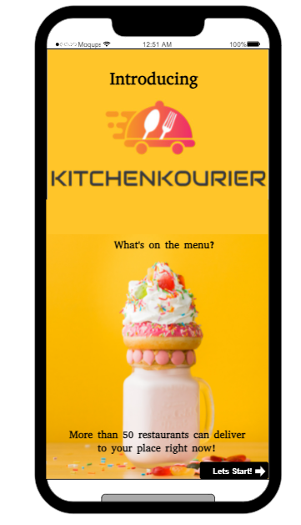
Mid-Term Presentation Group #18
Vatsal Kapadia -002747692
Monalika Pradhan-002768020
Krishnanand Jha-002768931
Yucong Feng - 001586064
Hrushitha puttala - 002795117

Slide 2
Contents
Problem Statement & Solution
Style Guide
Product Objectives
Target Audience
User Segmentation
User Needs
Onboarding
Use Cases
Personas
UX Research methods

Slide 3

1. Problem Statement
In today's fast-paced lifestyle, people often find it challenging to take time out for cooking meals, and this has led to a surge in the demand for food delivery apps.
However, despite the popularity of food delivery apps, there are still several pain points that users experience, such as delayed deliveries, inaccurate orders, poor customer service, and limited menu options.

Slide 4
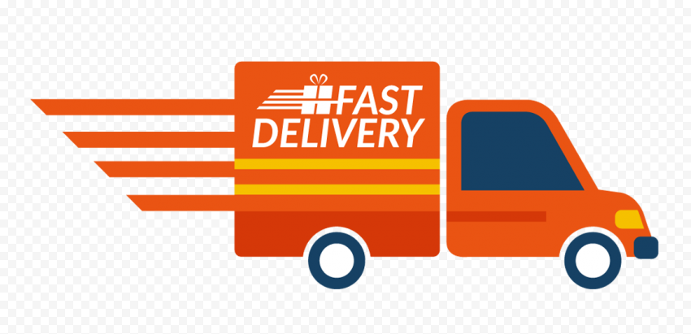
1. Solution
1. Fast and Accurate Delivery: The app can offer a faster delivery service by partnering with local restaurants and optimizing the delivery routes. The app can also ensure the accuracy of orders by using technology like artificial intelligence and machine learning to reduce errors.

Slide 5
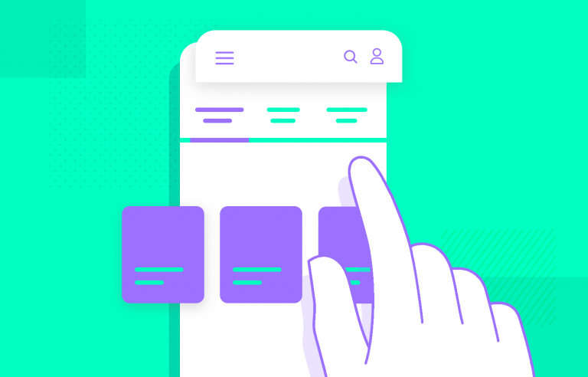
1. Solution
2. Wide Menu Options: The app can expand its menu options by partnering with more restaurants and food chains to cater to a wider range of customer preferences. It can also introduce seasonal menus and offer exclusive deals to retain customers.

Slide 6

1. Solution
3. Excellent Customer Service: The app can offer 24/7 customer service through multiple channels, such as phone, chat, and email. The app can also incentivize users to leave feedback and ratings after each order, which can help the app identify areas for improvement and address any issues promptly.

Slide 7
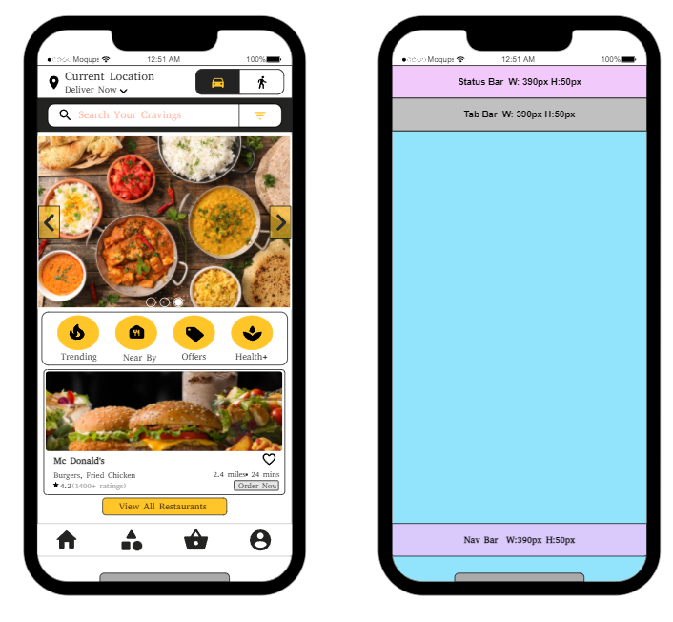
2. Style Guide
Units: pixels(px)
Screen dimensions:
W: 432, H: 866
Button dimensions:
W: 200, H: 26
Header Font Size: 30
Paragraph Font Size: 14

Slide 8



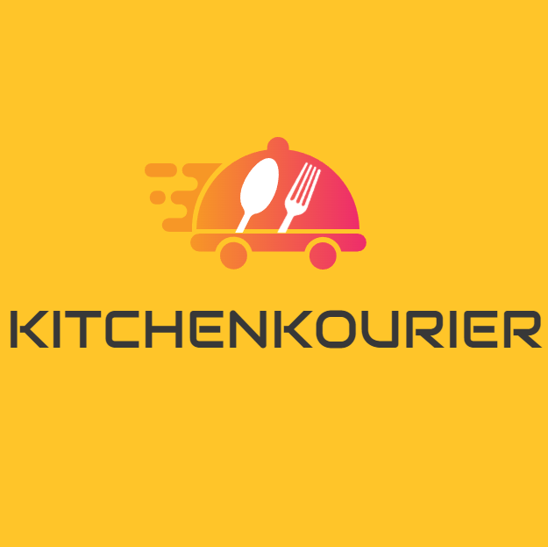
2. Color & Typography Guide
Primary
Secondary
Logo
#FFC529
#000000
#aaaaaa
Orange
Black
Grey
Primary Font: Abyssinica SIL
Homepage – 14px Regular, According to need
Category – 26px Regular, According to need
Buttons – According to need
Sign in/Sign up – 28px Bold, UPPERCASE

Slide 9
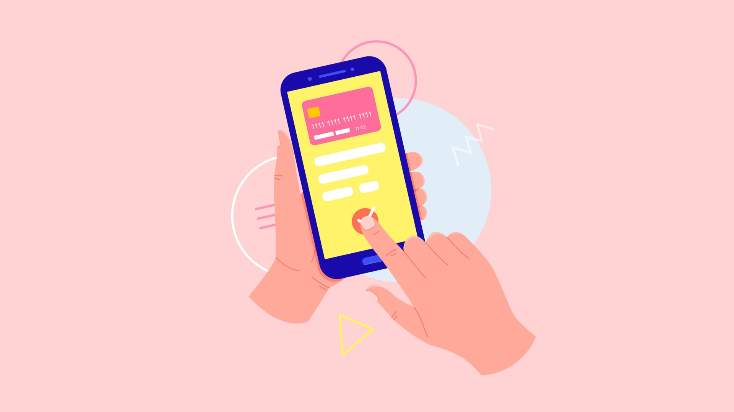

3. Product Objectives
1.The most important objective of the food delivery app is to create BUSINESS. With the technology advancement the app helps in connecting the restaurants and customers.
2.Convenience: Users should find it simpler to utilize the app to order meals from their preferred restaurants and have them delivered straight to their door.
3.Accessibility: The app should be usable by a variety of users, including those with impairments or limited access to technology.
4.Information such as open hours, distance, restaurant data and other information is put in the app which helps in providing a detailed idea for ordering food.
5.Customer Service: The app should provide responsive customer support that promptly and effectively addresses user complaints and feedback.

Slide 10
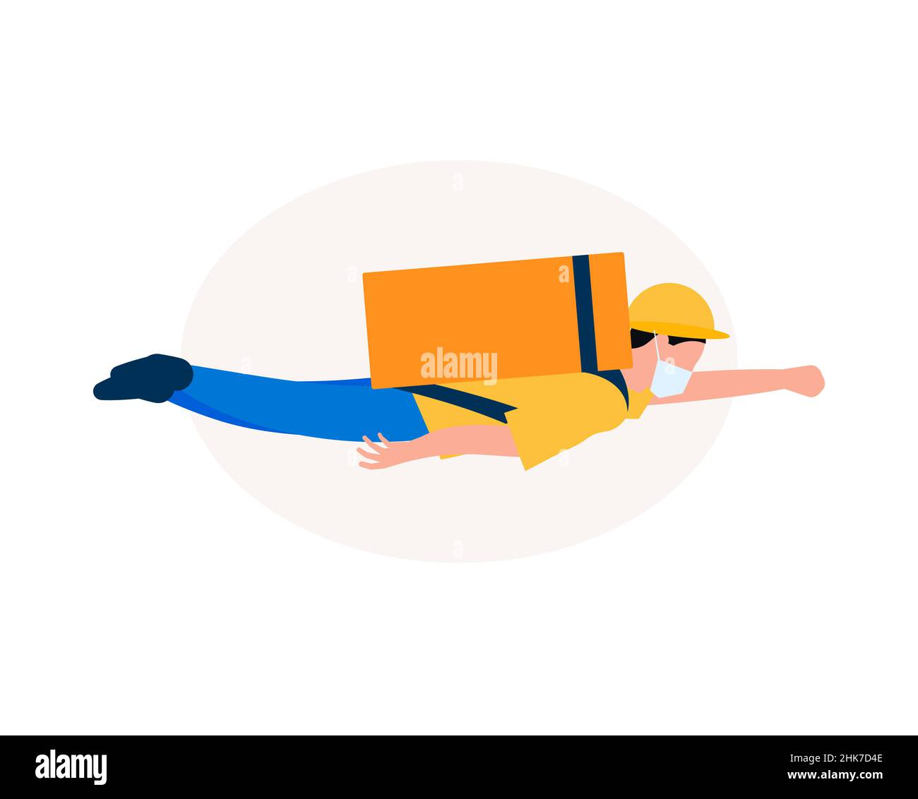
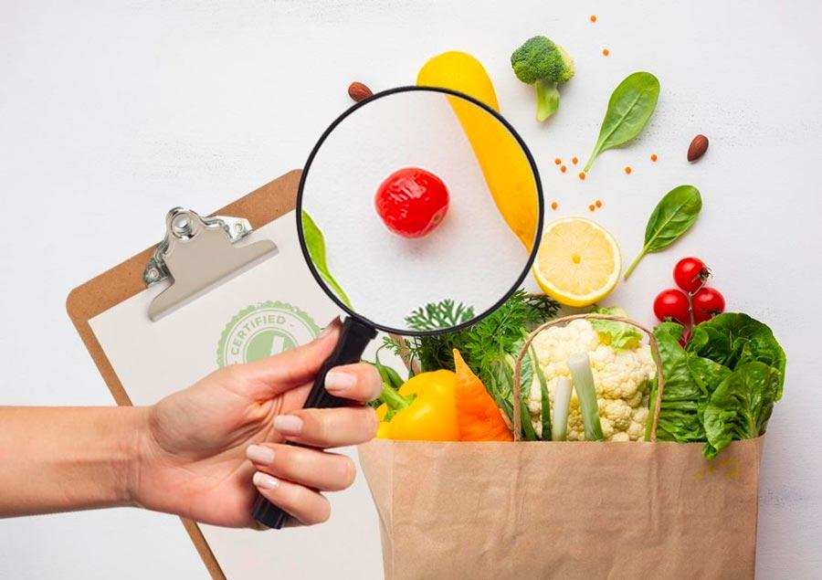
3. Product Objectives
6.Cost-Effectiveness: The app should provide reasonable prices for food orders and delivery costs so that customers may afford it
7.Selection: A wide range of restaurants and menu items, as well as options for various dietary preferences and limitations, should be available on the app.
8.Speed: The app should make sure that clients receive their meal orders on time, with minimal or no problems. Ease of Use: The app should be simple to use and intuitive so that users can easily navigate and place orders.
9.Personalization: To enhance the user experience overall, the app should provide personalized recommendations based on user preferences and order history.
10.Safety: Security: The app needs to put user security first by making sure that food orders are produced and delivered in a hygienic and secure manner.

Slide 11


4. Target Audience
Age Specifications: 18-80 years
1. Busy people: People in this category include those who are employed, students, and parents looking for a quick meal.
2. Individuals who value convenience: These are those who would rather avoid the hassle of meal preparation by ordering food online rather than dining out or cooking at home.
3. Those who are concerned with their health: This group of people includes those who are interested in eating healthier meals or who adhere to a certain diet regimen.
4. Tech-savvy individuals: Individuals who are comfortable using technology and prefer ordering food through mobile applications over more traditional means fall into this category.

Slide 12
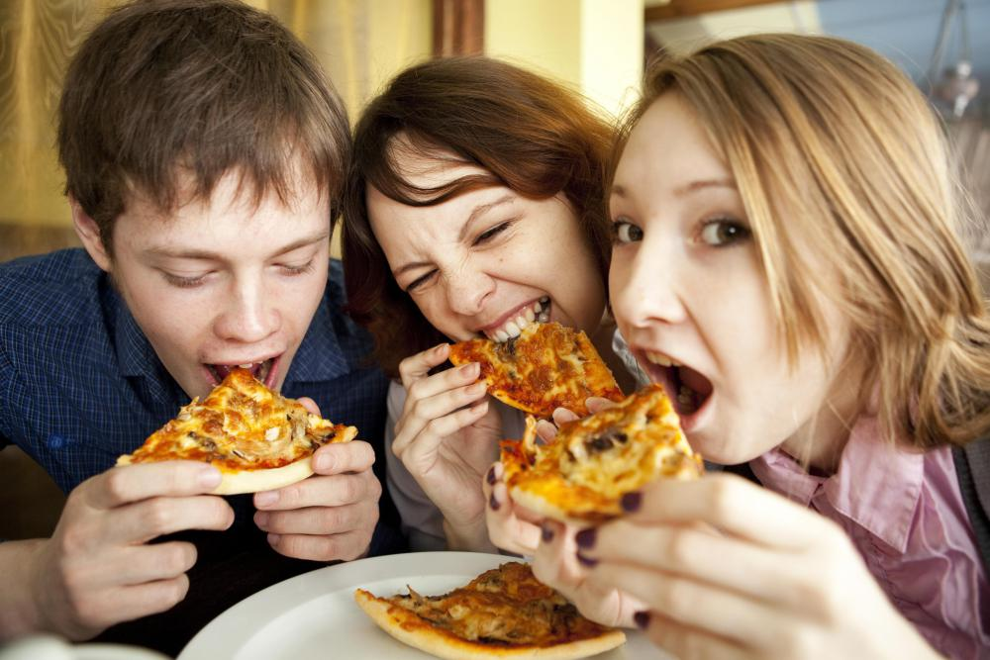
4. Target Audience
5. Foodies: Foodies are people who have a strong interest in food and are keen to try different cultures and cuisines.
6. Elderly People: Individuals in their senior years who can't cook and want simple, healthy meals delivered right to their door
7. Tourists: A possible market for food delivery applications could be travelers who are visiting a new location and are unfamiliar with the local cuisine. They can be seeking for choices that suit their dietary requirements as well.
8. Cloud Kitchens and Restaurants: This is for the vendor side user that’ll be present on the app and will help us with the cooking of meals.

Slide 13
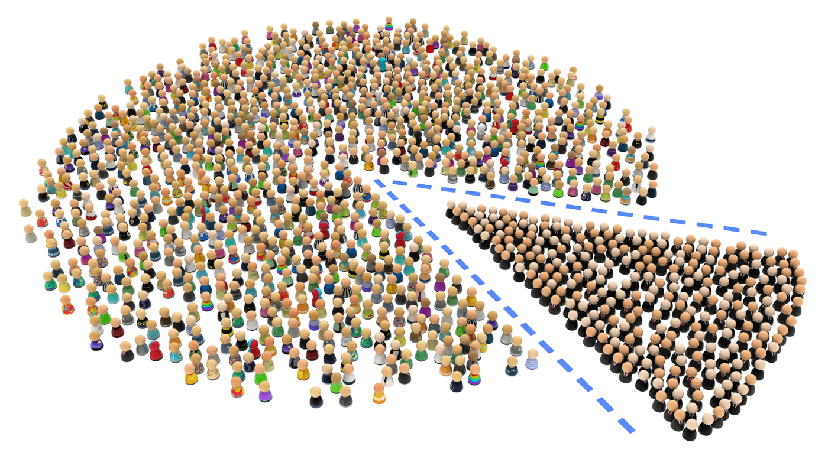
5. User Segmentation
The process of grouping users according to their traits, behaviors, or needs is known as user segmentation. Examples of user segmentation for a food delivery app include the following:
Geographic segmentation: Depending on where they are, users might be divided into urban, suburban, or rural areas.
Demographic segmentation: Segmenting users based on their age, gender, income, level of education, and other characteristics
Behavioral segmentation: Users can be divided into groups based on their behavior, including how frequently they place orders, how much they spend on those orders, and what kind of food they like to eat.

Slide 14
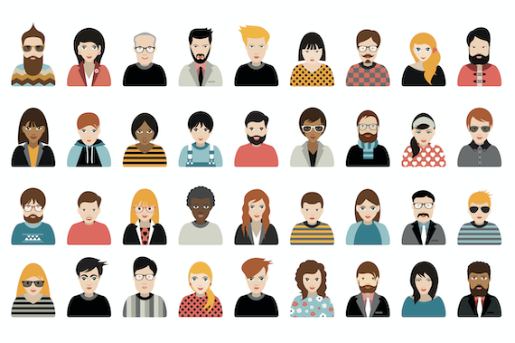
5. User Segmentation
3. Psychographic segmentation: User segmentation based on personality, values, interests, and lifestyle
4. Occasion segmentation: Segmenting users by event, such as office lunches, family meals, or dating nights, is a possibility. A food delivery app can form its marketing and product offers to fit the unique requirements and tastes of its customers by understanding the target demographic and utilizing user segmentation tactics, thereby increasing user engagement and retention.

Slide 15




6.User Needs
Convenience
Variety
Reliability
Quality
A fast and easy way to order food
An access to a wide range of menu options
Trust the app to deliver their food accurately and on time
Can receive their food in good condition

Slide 16




6.User Needs
User-friendly interface
Real-time updates
Payment options
Customer support
Intuitive and easy-to-use interface to place their orders
Track the status of their orders in real-time
Various payment options: online and cash on delivery
24 X 7 customer support to the users

Slide 17
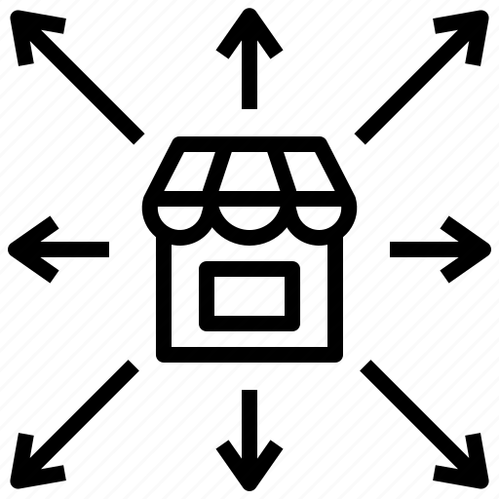

6.User Needs
Expansion
Continuous improvement
The app continually expands the number of restaurants
Take their feedback into account and make improvements

Slide 18
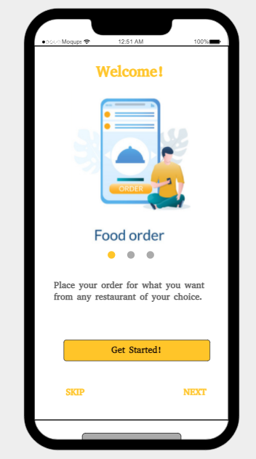
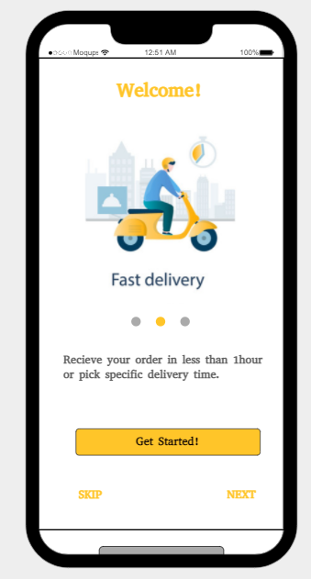
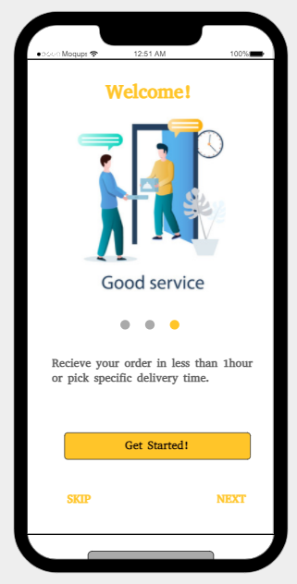
7.Onboarding – Slide Explanation
When a user first opens the app, they may not be familiar with how it works or where to find certain features, such as tracking their delivery or customizing their orders.
A slide explanation can provide a step-by-step guide to help users navigate the app and understand how to use it to its full potential.

Slide 19
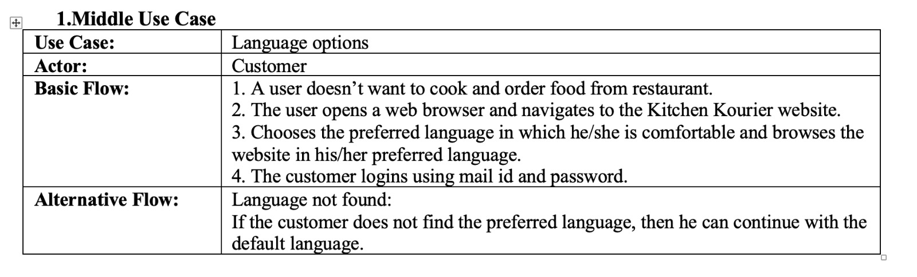
8. Use Cases

Slide 20
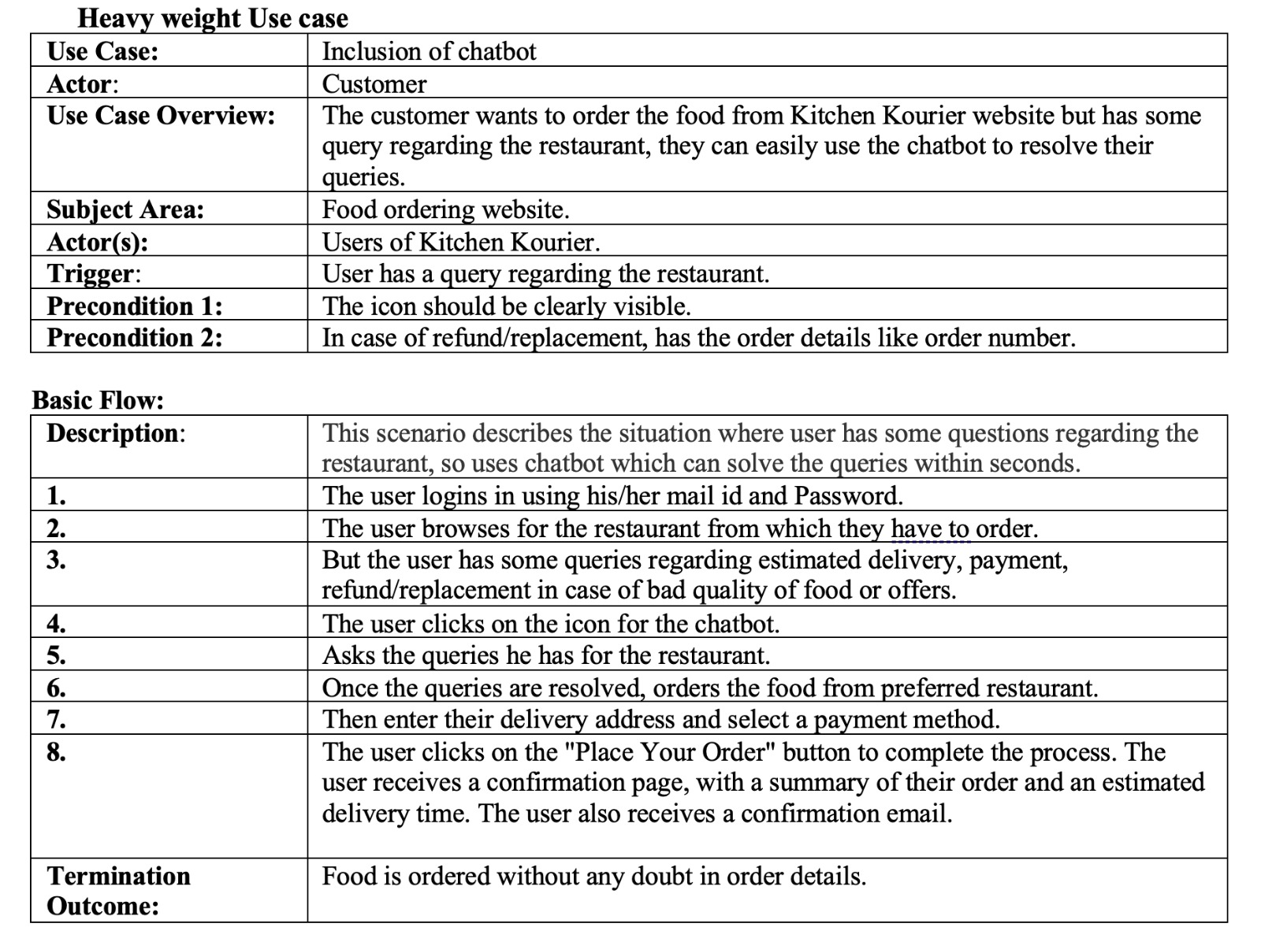
8. Use Cases

Slide 21
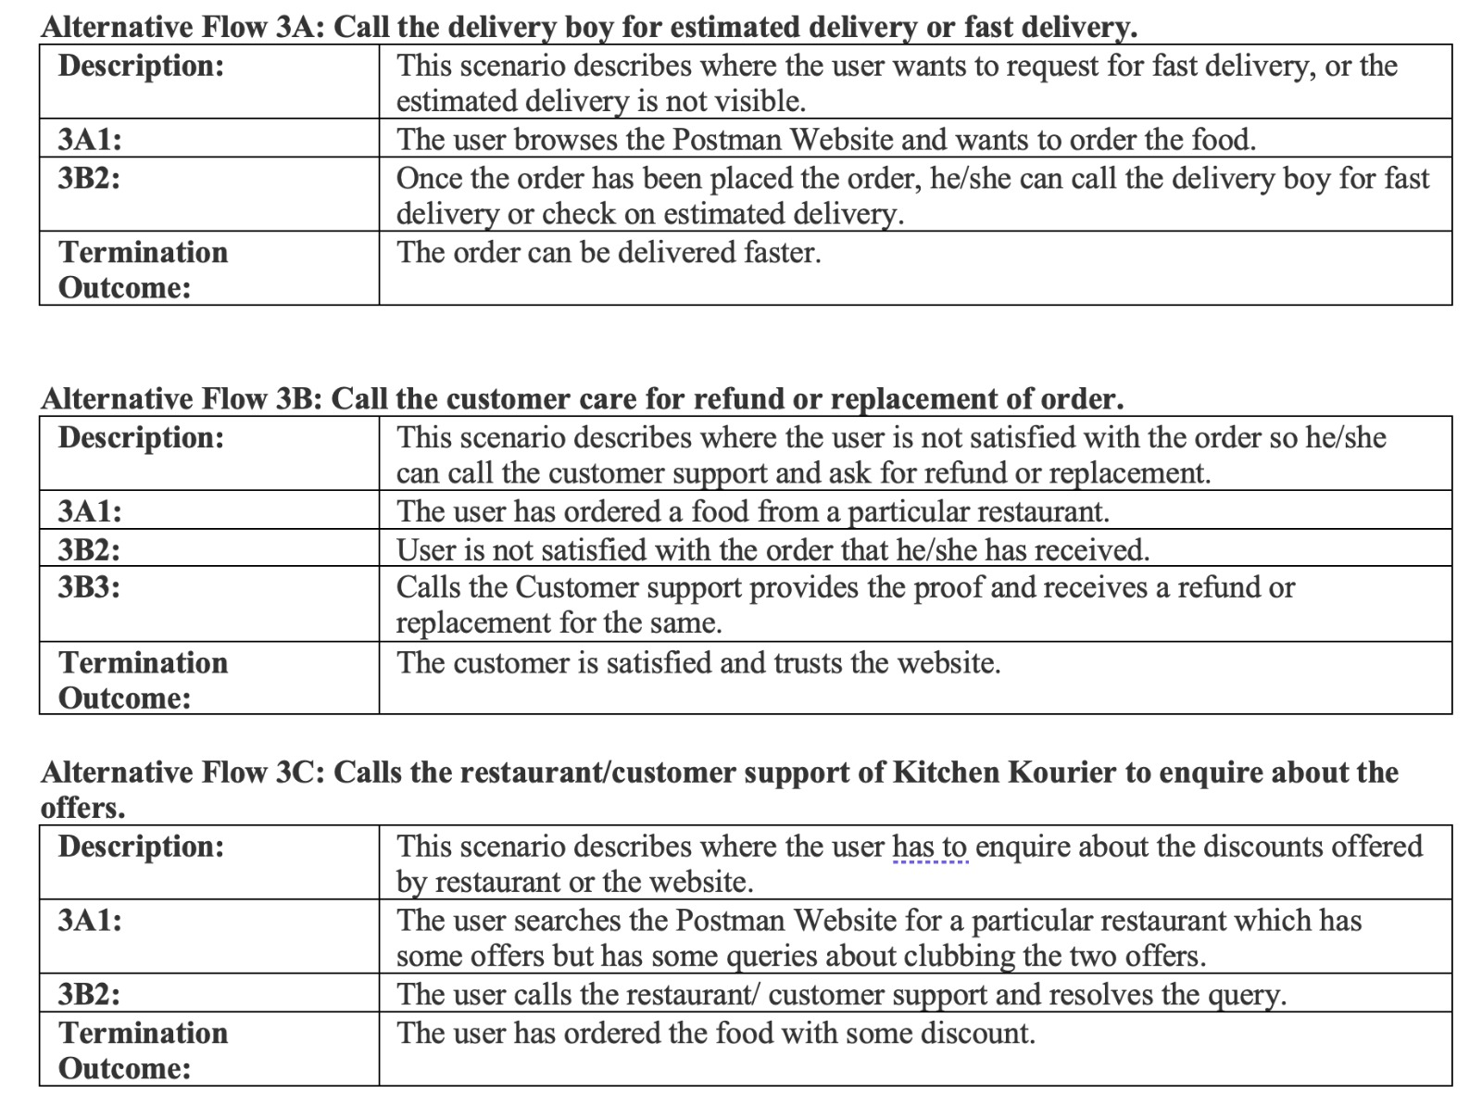
8. Use Cases

Slide 22
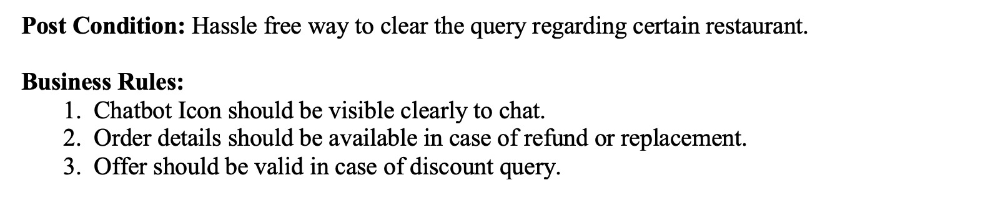
8. Use Cases

Slide 23
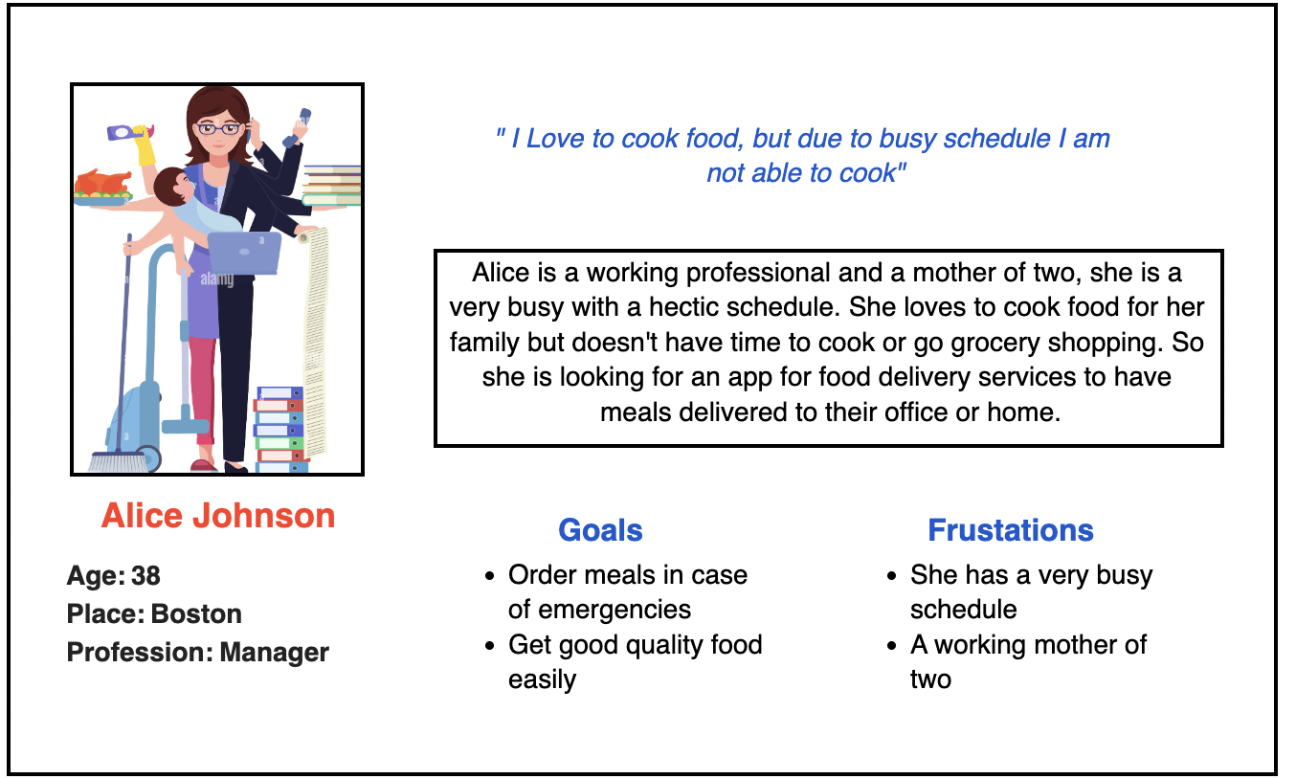
9. Personas

Slide 24
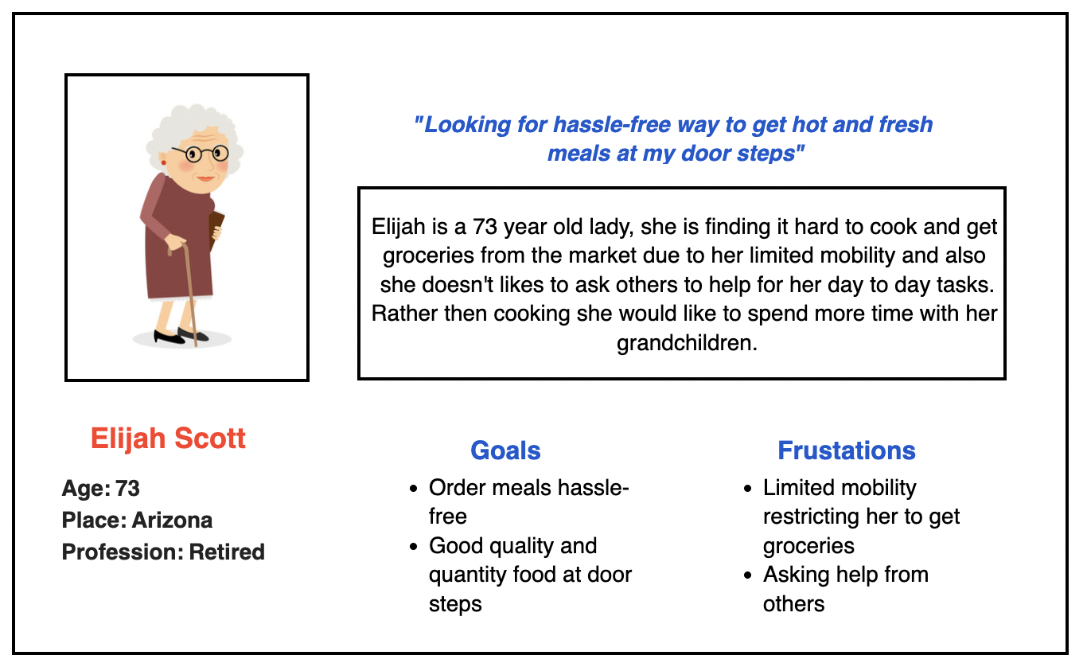
9. Personas

Slide 25
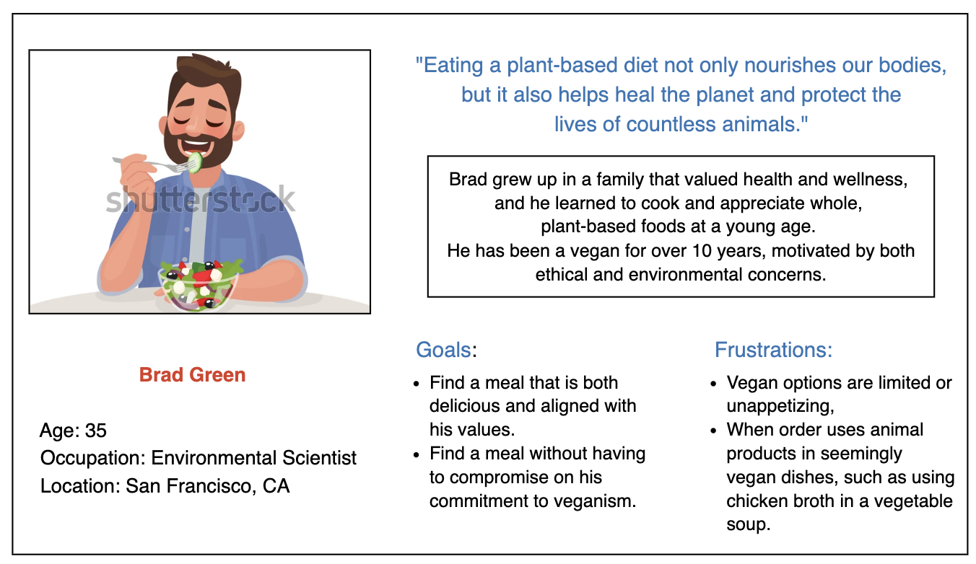
9. Personas

Slide 26
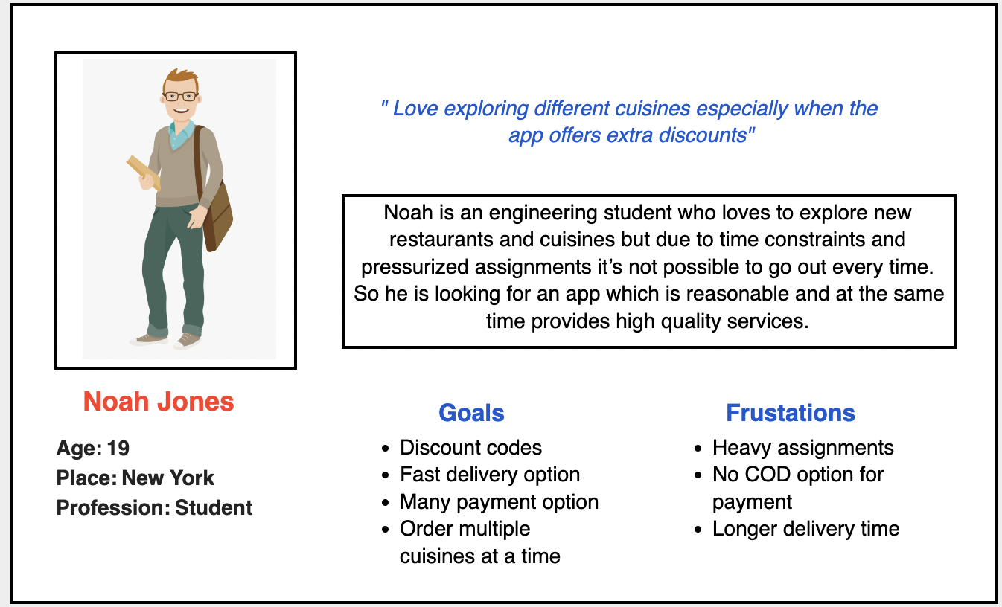
9. Personas

Slide 27
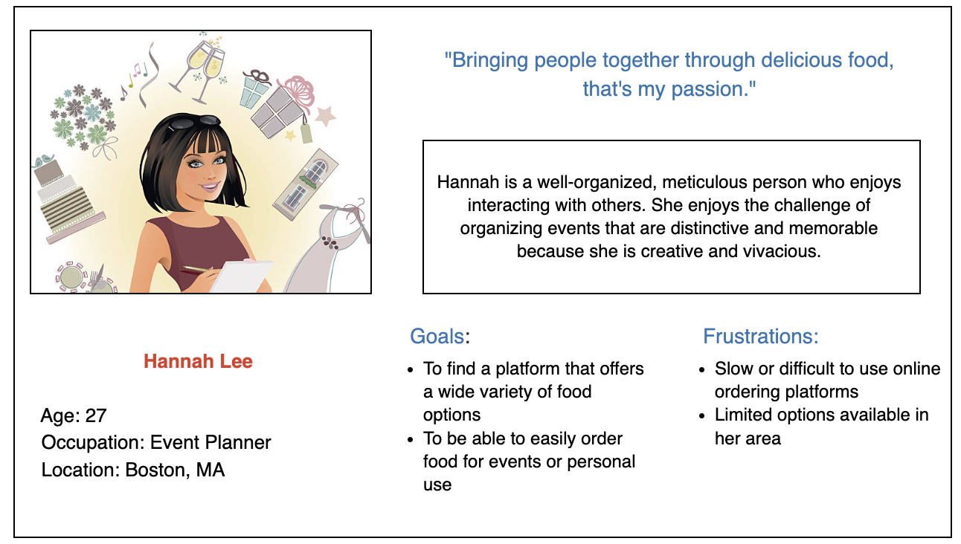
9. Personas

Slide 28
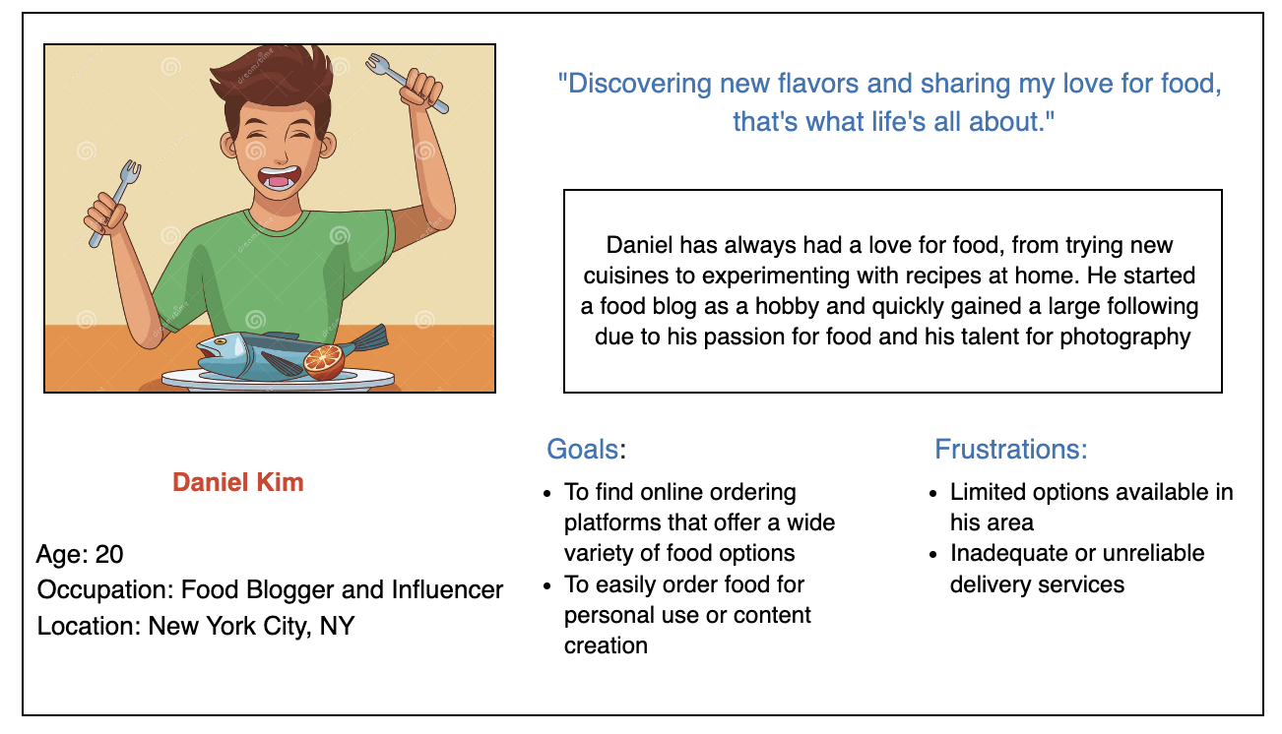
9. Personas

Slide 29
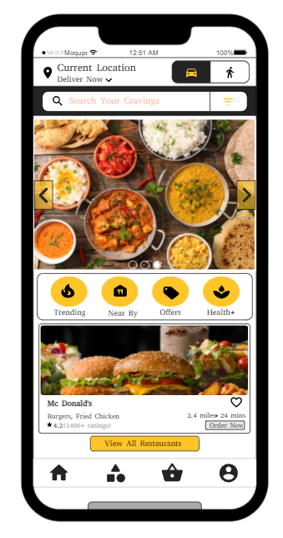
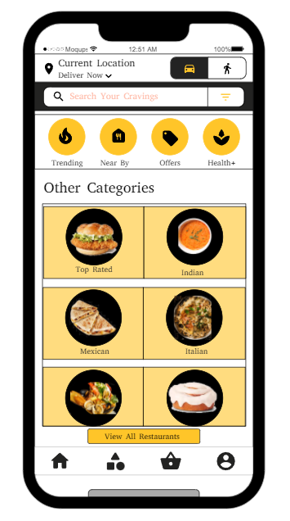
10.UX Research methods we applied
Card sorting
1. Identifying the key categories of information that users expect in a product or system.
2. Creating a navigation structure that is intuitive and easy to use
For a food delivery app, card sorting could involve organizing the menu options into categories.

Slide 30
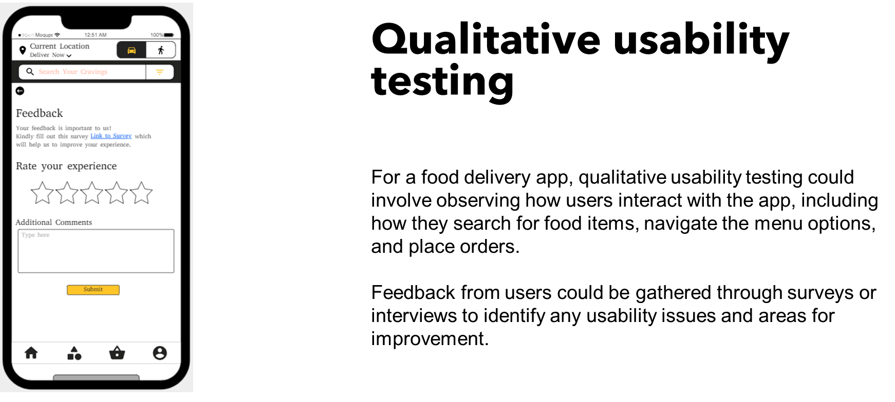
10.UX Research methods we applied

Slide 31
